Slide 1
D.A. DAVIDSON 21st ANNUAL DIVERSIFIED INDUSTRIALS & SERVICES CONFERENCE
SEPTEMBER 22, 2022

Slide 2
FORWARD-LOOKING STATEMENTS AND NON-GAAP FINANCIAL DISCLOSURES
Forward-Looking Statements
This material and related presentation contain certain forward-looking statements. Such statements speak only as of the date on the cover of this slide deck, and EMCOR assumes no obligation to update any such forward-looking statements, unless required by law. These forward-looking statements may include statements regarding anticipated future operating and financial performance, including financial guidance and projections underlying that guidance; the nature and impact of our remaining performance obligations; our ability to pursue acquisitions; our ability to return capital to shareholders; market opportunities; market growth prospects; customer trends; and our ability to maintain a strong safety record. These forward-looking statements involve risks and uncertainties that could cause actual results to differ materially from those anticipated (whether expressly or implied) by the forward-looking statements. Accordingly, these statements do not guarantee future performance or events. Applicable risks and uncertainties include, but are not limited to, adverse effects of general economic conditions; changes in interest rates; domestic and international political developments; changes in the specific markets for EMCOR’s services; adverse business conditions, including labor market tightness, productivity challenges, the nature and extent of supply chain disruptions impacting availability and pricing of materials, and inflationary trends more generally, including fluctuations in energy costs; the availability of adequate levels of surety bonding; increased competition; unfavorable developments in the mix of our business; and the continuing impact of the COVID-19 pandemic, including the nature, extent, and impact of future variant surges, as well as other health emergencies, and government orders and mandates related thereto, on our revenue and operations. Certain of the risk factors associated with EMCOR’s business are also discussed in Part I, Item 1A “Risk Factors,” of the Company’s 2021 Form 10-K, and in other reports we file from time to time with the Securities and Exchange Commission and available at www.sec.gov and www.emcorgroup.com. Such risk factors should be taken into account in evaluating our business, including any forward-looking statements.
Non-GAAP Measures
This material and related presentation may include certain financial measures that were not prepared in accordance with U.S. generally accepted accounting principles (GAAP). The Company uses these non-GAAP measures as key performance indicators for the purpose of evaluating performance internally. We also believe that these non-GAAP measures provide investors with useful information with respect to our ongoing operations. Any non-GAAP financial measures presented are not, and should not be viewed as, substitutes for financial measures required by GAAP, have no standardized meaning prescribed by GAAP, and may not be comparable to the calculation of similar measures of other companies.

Slide 3
EMCOR HIGHLIGHTS
Leading specialty construction, building, and industrial services provider
Approximately 76 million hours worked in 2021
2021 Total Recordable Incident Rate (TRIR) of 1.06
2022 Qtr. 2 RPOs of $6.46B

Slide 4
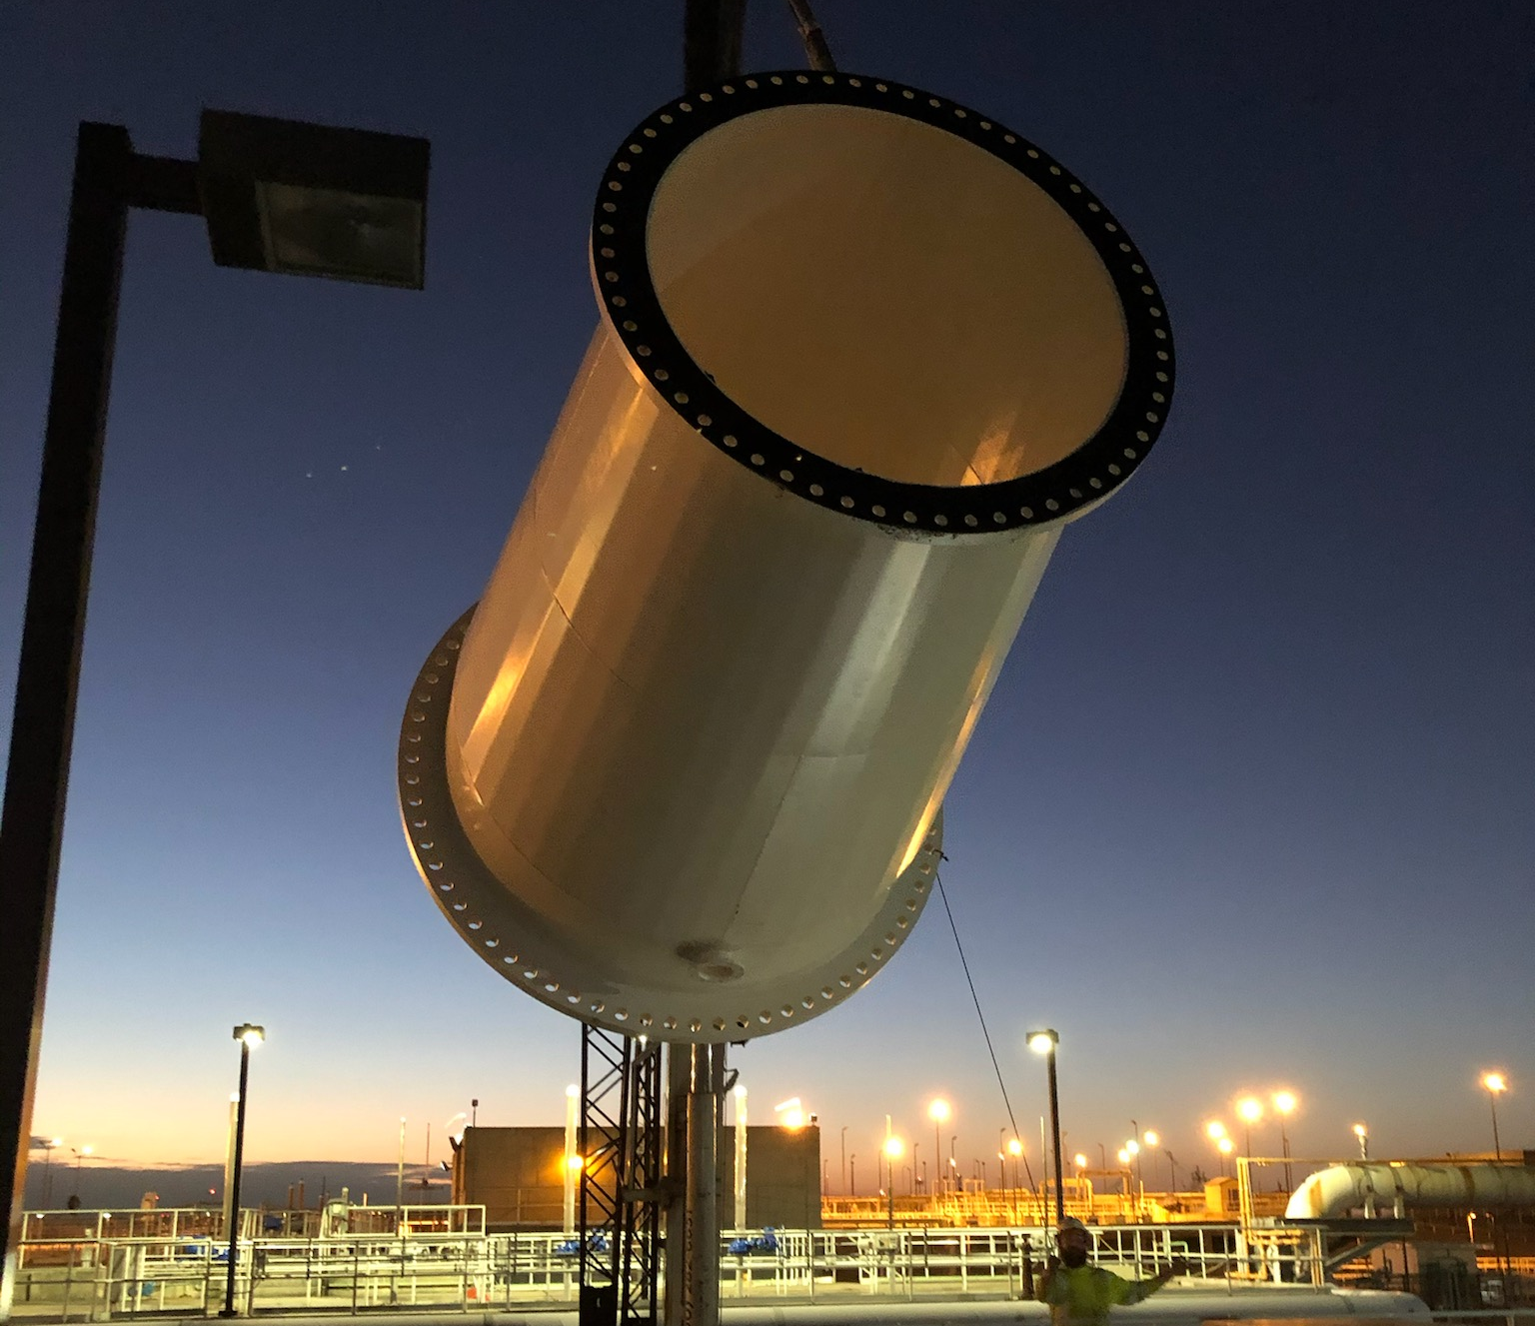
Emcor strengths
Significant expertise in project execution and managing skilled craft labor
Disciplined and effective cost management
Broad opportunities for earnings growth
History of consistent cash generation
Strong and liquid balance sheet

Slide 5
BROAD CONSTRUCTION & SERVICES PLATFORM 2021 REVENUES: $9.9B
CONSTRUCTION * |  |  | SERVICES
CONSTRUCTION SERVICES |  |  | BUILDING SERVICES |  |  |  |  |  |  |  | INDUSTRIAL SERVICES
Mechanical | Electrical |  | Mobile | Site-Based |  | Government |  |  | EMCOR UK |  | Refinery / Petro Chemical / Turnaround Services
Revenues $3.9B | Revenues $2.0B |  | Revenues $2.5B |  |  |  |  |  | Revenues $0.5B |  | Revenues $1.0B
Sheet Metal HVAC Process Piping High Purity Piping Plumbing Fire Protection Water and Wastewater | Low Voltage Voice & Data Lighting Security/Alarm High Voltage Transmission & Distribution Sustainable Energy Solutions |  | National HVAC Service Building Control Systems Retrofit Projects Repair Services Service Agreements IAQ Services | O&M HVAC Services Retrofit Projects Preventive Maintenance Energy Efficiency Upgrades | O&M HVAC Services Retrofit Projects Preventive Maintenance Energy Efficiency Upgrades | Base Ops Facilities Management IDIQ Projects O&M Supplier Management | Base Ops Facilities Management IDIQ Projects O&M Supplier Management |  | Integrated Facilities Services O&M Supplier Management |  | Heat Exchanger Services / Fabrication Embedded Contracts Turnaround Services Specialty Welding Maintenance & Capital Projects Process Controls Renewable Energy / Solar
* ~15% of construction revenues are services

Slide 6
GROWTH OPPORTUNITIES
Well-positioned in growing non-residential markets / trades
Data Centers / Semiconductor Fabs | Strong Electrical / Mechanical / Fire Protection demand across numerous geographic regions; RPOs continue to grow
Industrial / Manufacturing | Growing Electrical / Mechanical opportunities driven by continued re-shoring of supply chain to Southeast and relocations from higher-cost states Additional food processing and cold storage opportunities Installation of electric vehicle/truck charging stations
Healthcare | Electrical / Mechanical system retrofits as hospitals upgrade their existing facilities and build new facilities
Water & Wastewater | Demand for comprehensive construction services, especially Florida
Mechanical Services | Growing Mechanical service and repair demand stemming from pandemic maintenance deferrals, retrofit opportunities, energy efficiency upgrades and unavailability of new HVAC equipment
Indoor Air Quality | Nationwide Mechanical systems retrofit projects to improve building wellness with significant opportunities in the Institutional and Education sectors
Fire Protection | Nationwide fire sprinkler installation capability / substantial cost efficiencies via prefabrication / strong demand from industrial and technology clients / growing aftermarket

Slide 7
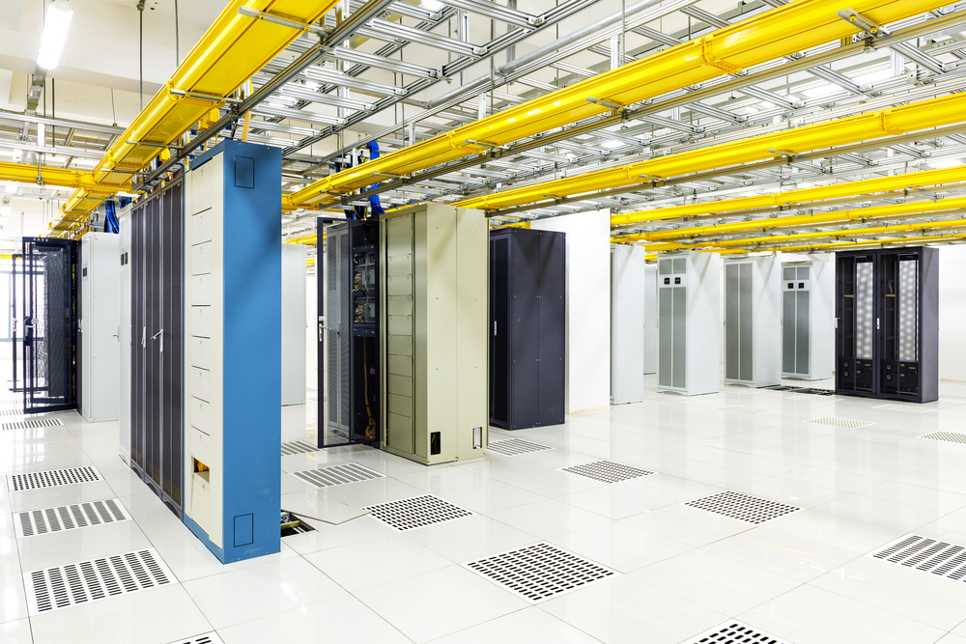
MARKET OUTLOOK – DATA CENTERS
Demand across Mid-Atlantic, Pacific Northwest, Midwest, and the Southeast remains strong
Electrical Construction
Mechanical Construction
Fire Protection Systems
CUSTOMER BASE
Technology Companies
Financial Firms
Co-locators
Government
“Average” Data Center Build % Ranges
Electrical Construction 30% - 50% *
Mechanical Construction 15% - 35% *
Fire Protection (Sprinkler Installation) 3% - 7%
* Includes purchase of major equipment

Slide 8
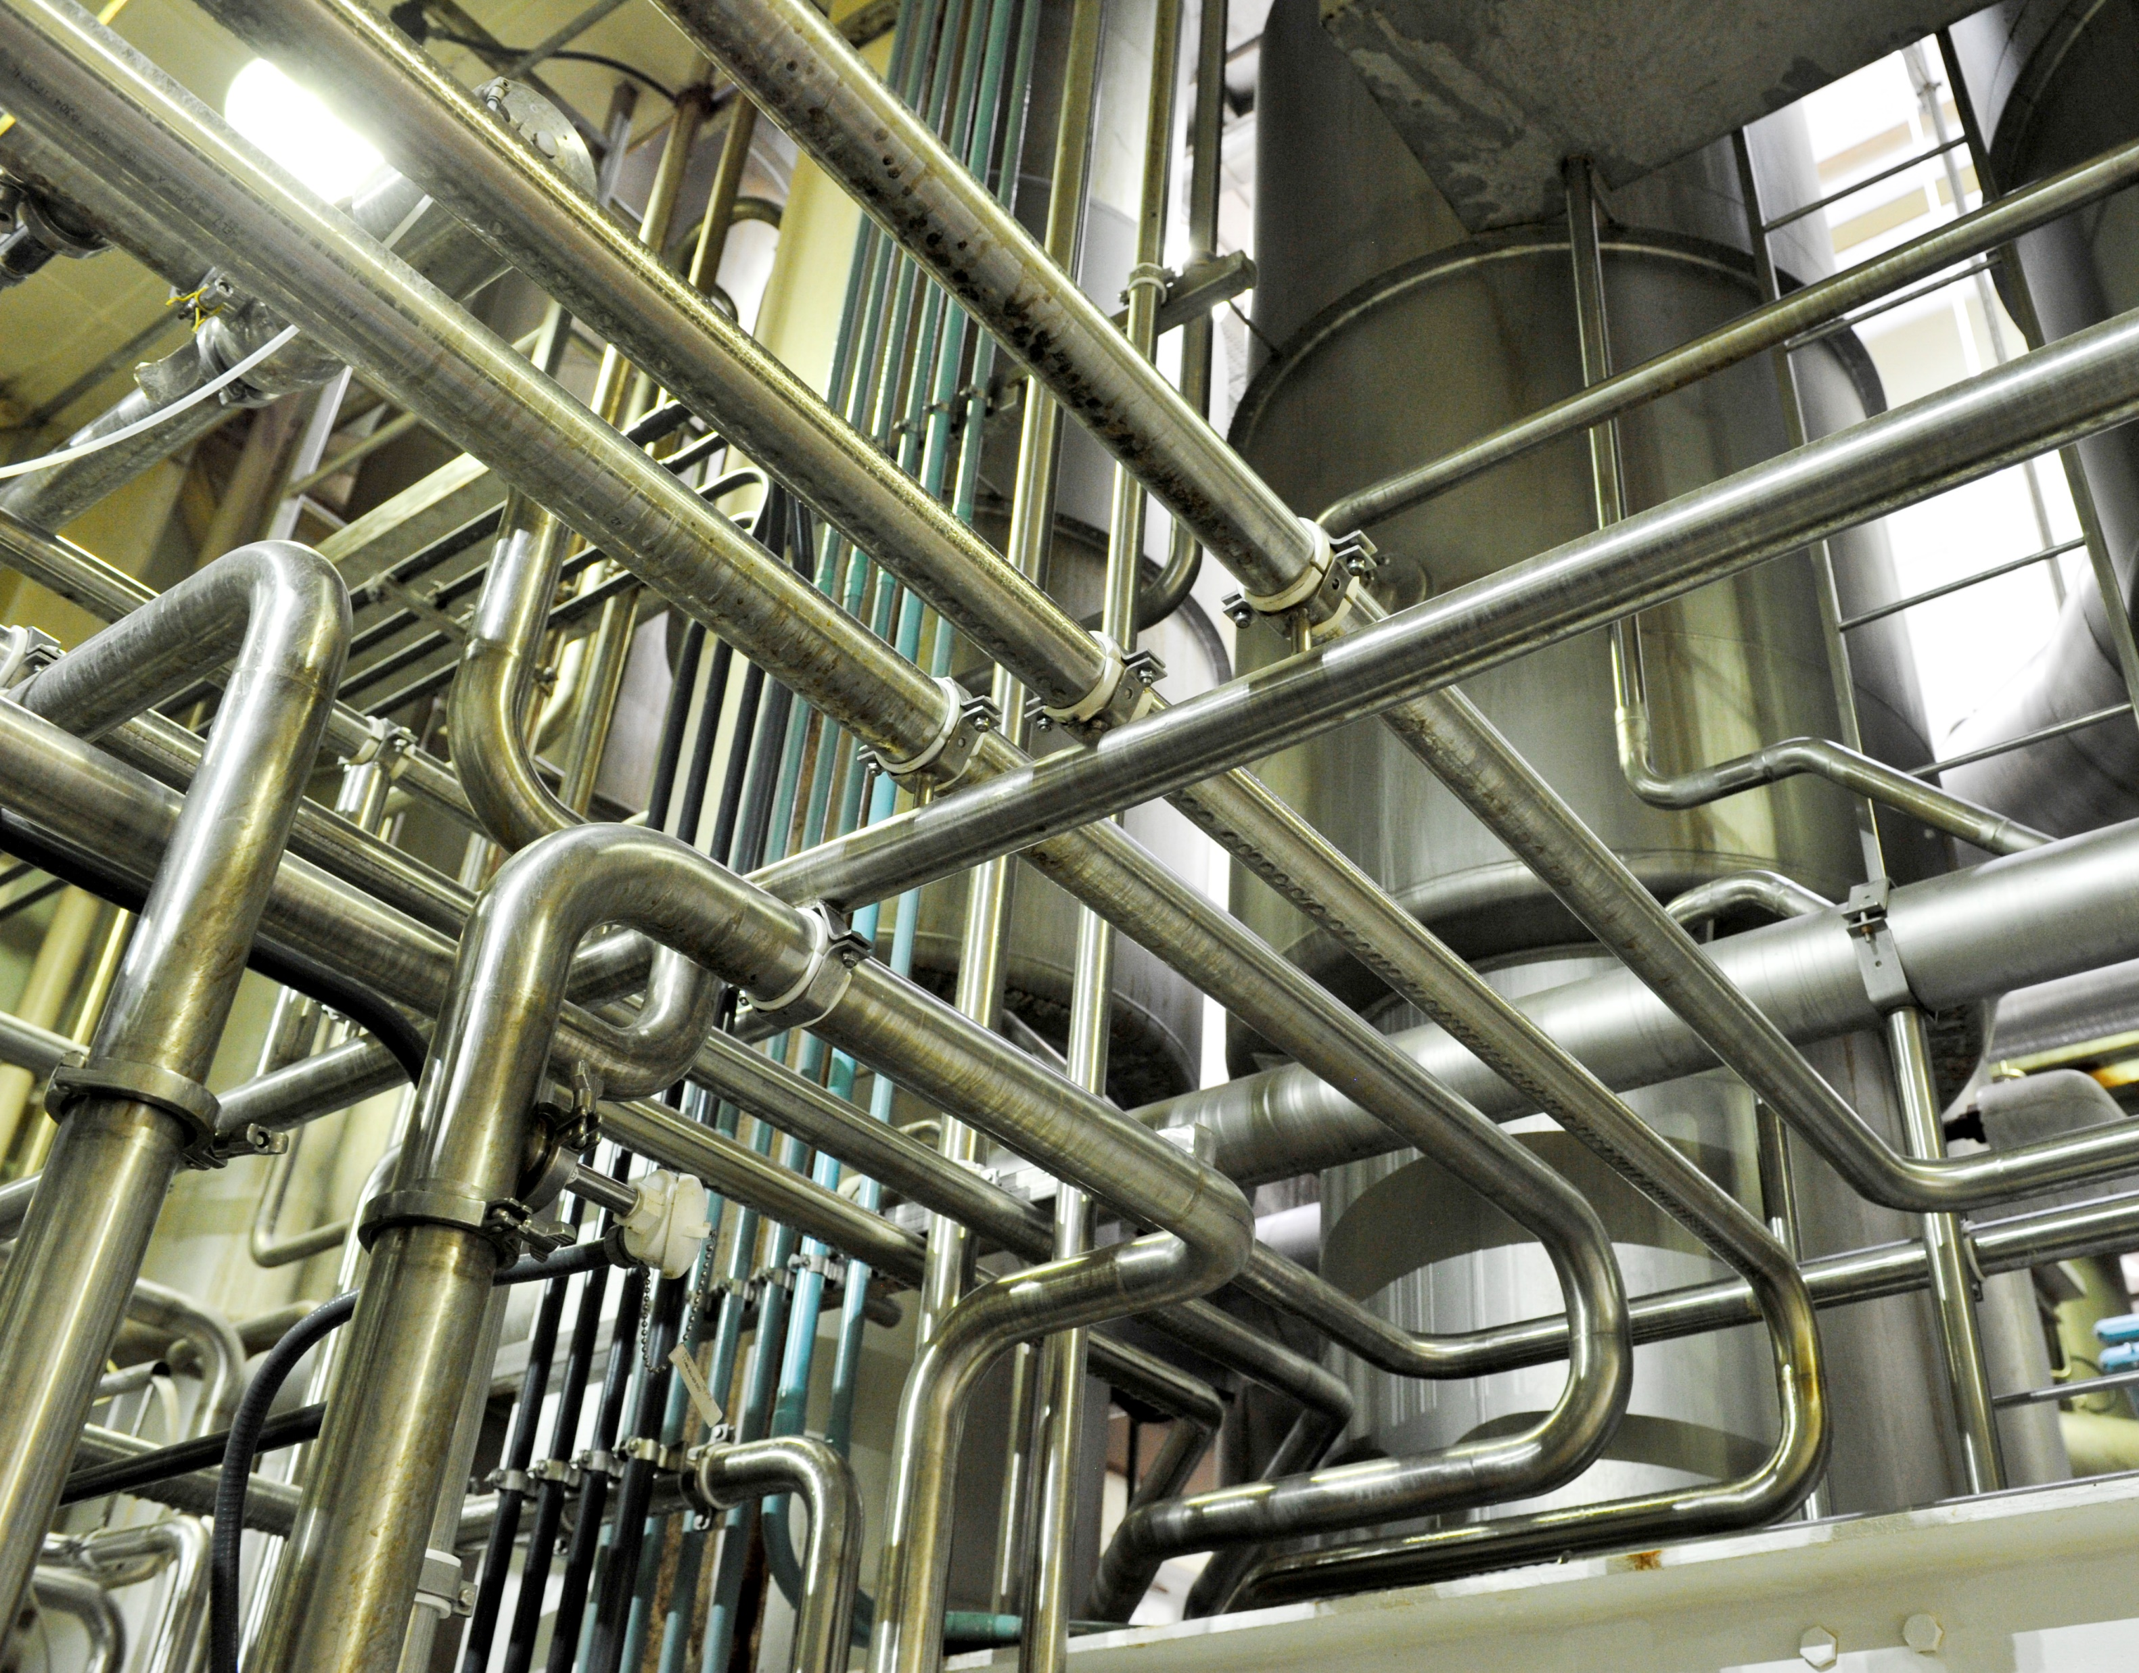
MARKET OUTLOOK – INDUSTRIAL / MANUFACTURING
Well-positioned for continued and increased investment in:
Re-shoring of Critical Supply
Food Processing
High-Tech / Semiconductor
Pharmaceuticals
Building Products
Energy – Traditional / Renewable

Slide 9
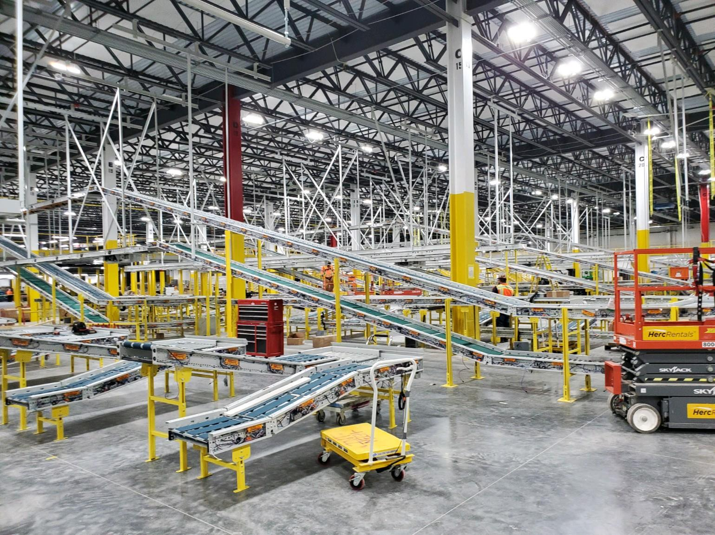
MARKET OUTLOOK – SUPPLY CHAIN SUPPORT / BUILD OUT
E-Commerce supply chain driving strong fire protection demand / moderate electrical services demand
Fire Protection Systems
Mechanical Construction
Active Aftermarket
CUSTOMER BASE
Technology Companies
Food Processing / Cold Storage
Distribution Centers

Slide 10
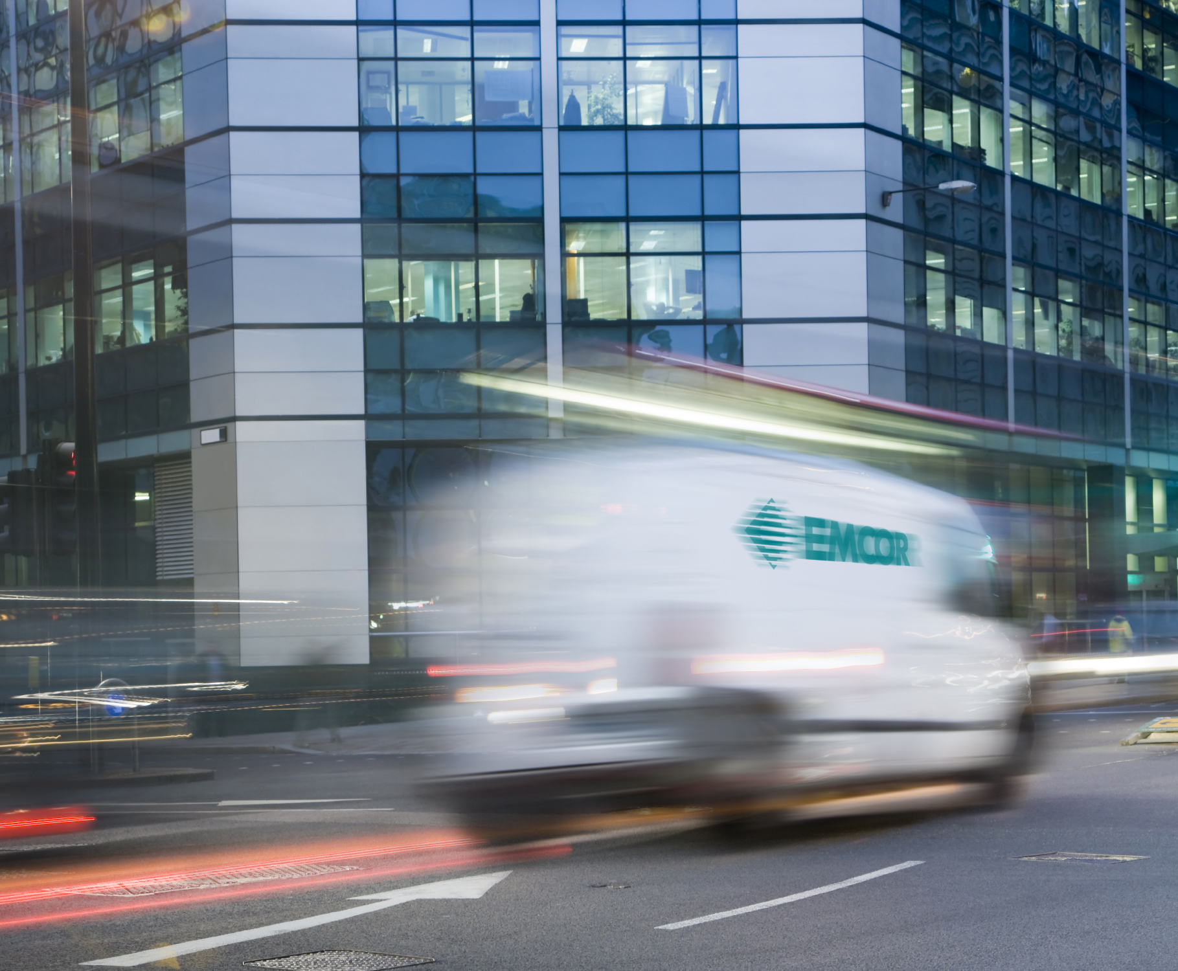
MARKET OUTLOOK – MECHANICAL SERVICES
Growing demand stemming from maintenance deferrals, retrofit opportunities, efficiency upgrades, and IAQ
Mobile Mechanical Services
Building Automation & Controls
Onsite Facilities Services
Government Services
CUSTOMER BASE
Commercial Buildings
National Brands and Organizations
Federal, State, and Local Government
Specialized Environments
Other Institutional Facilities
K-12 Schools / Universities
Healthcare Facilities

Slide 11
RPOs BY MARKET SECTOR – 6/30/22
Diverse Remaining Performance Obligations (RPOs) of $6.46 billion
7%
($ Millions) (Unaudited)
6/30/22
8%
3%
11%
48%
11%
10%
2%

Slide 12
PRIORITIZING SUSTAINABILITY
Our Mission First, People Always values continue to guide our sustainability strategy
Recent Updates
Aligned our sustainability reporting with the Sustainability Accounting Standards Board (SASB) standard for the Engineering & Construction Services industry, in-line with our shareholders’ expectations and our commitment to strong sustainability practices Incorporated guidance from the recommendations of the Task Force on Climate-Related Financial Disclosures (TCFD) to disclose scope 1 and scope 2 greenhouse gas emissions metrics and set forward-looking reduction goals
Our Initial 2035 Energy and Emissions Goals
Committed to the Health & Safety of our Workforce
30-40%
Per capita reduction in carbon-based fuel consumption across service fleet
We maintain a strong commitment to safety throughout our operations, striving for a zero injury environment and culture across our 90 operating subsidiaries
2021
TRIR
Industry Average
20%
Reduction in per capita greenhouse gas output
1.06
2.70
We maintain our position as an industry leader in safety and continue to make progress toward our goal of zero workplace injuries
Our Board and management team continue to oversee our ESG practices and guide our strategy as we progress our goals and initiatives

Slide 13
KEY FINANCIAL DATA – INCOME STATEMENT
($ Thousands, except per share information)

Slide 14
KEY FINANCIAL DATA – BALANCE SHEET
($ Thousands)

Slide 15
BALANCED CAPITAL ALLOCATOR
EMCOR Capital Allocation by Year (%)
~50%
~50%
(YTD)
(YTD)
Business Reinvestment
Shareholder Return
Acquisitions
Capex
Dividends
Share Repurchases

Slide 16
2022 OUTLOOK FOR REMAINDER OF YEAR
First and continuing priority – focus on employee health and safety
Non-residential market is projected to continue to grow in 2022
Strong HVAC repair service work driven by lack of new equipment availability and summer heat
Energy efficiency upgrades driving HVAC retrofit and replacement projects
Oil & gas markets continue to improve
Stalled renewable projects could ramp up in second half of year
U.K. strong and stable
Fuel and energy costs to remain a headwind
Macro uncertainties, including supply chain disruptions, inflation, rising interest rates, the Ukraine conflict, and COVID could impact us over the remainder of the year
Maintain the flexibility provided by our strong and liquid balance sheet

Slide 17
GUIDANCE ASSUMPTION UPDATE
Lingering COVID, inflation, and supply chain disruptions continue to contribute to a challenging 2022 operating environment
Original 2022 Assumptions
Qtr. 2 2022 Update
Non-res. market projected to grow
Up mid-single digits
Healthy organic revenue growth
9.7% quarterly organic revenue growth
Market for IAQ, energy efficiency, repair service and small project work would be strong
Stronger HVAC repair services
Fundamentals improving so far this year
Rebounding to more normal operating environment
Oil & gas markets expected to improve
Secular growth markets (infrastructure, data centers, healthcare, manufacturing) would be strong
Secular growth markets remain strong and continue to drive growth
Labor market would be challenging
Managing challenging labor market; however, skilled labor shortages persist in certain markets
COVID and Ukraine conflict continue to create a challenging operating environment
Supply chain disruptions continue for major equipment and systems
Lead times continue to increase well beyond normal levels
Suppliers not meeting promised delivery dates
Macro uncertainties of supply chain disruption, inflation, COVID, and increased mandates could impact year

Slide 18
2022 GUIDANCE
Assuming the impact of the COVID-19 pandemic and supply chain disruptions do not worsen
Revenues ~$10.8 Billion
Diluted EPS* $7.30 - $7.80
* Assumes 27.0% - 28.0% effective tax rate

