Slide 1
EMCOR GROUP, INC.
February 23, 2023

Slide 2
FORWARD-LOOKING STATEMENTS AND NON-GAAP FINANCIAL DISCLOSURES
Forward-Looking Statements
This material and related presentation contain certain forward-looking statements. Such statements speak only as of the date on the cover of this slide deck, and EMCOR assumes no obligation to update any such forward-looking statements, unless required by law. These forward-looking statements may include statements regarding anticipated future operating and financial performance, including financial guidance and projections underlying that guidance; the nature and impact of our remaining performance obligations; our ability to pursue acquisitions; our ability to return capital to shareholders; market opportunities; market growth prospects; and customer trends. These forward-looking statements involve risks and uncertainties that could cause actual results to differ materially from those anticipated (whether expressly or implied) by the forward-looking statements. Accordingly, these statements do not guarantee future performance or events. Applicable risks and uncertainties include, but are not limited to, adverse effects of general economic conditions; changes in interest rates; domestic and international political developments; changes in the specific markets for EMCOR’s services; adverse business conditions, including labor market tightness, productivity challenges, the nature and extent of supply chain disruptions impacting availability and pricing of materials, and inflationary trends more generally, including fluctuations in energy costs; the impact of legislation and/or government regulations; the availability of adequate levels of surety bonding; increased competition; unfavorable developments in the mix of our business; and the continuing impact of the COVID-19 pandemic, including the nature, extent, and impact of future variant surges, as well as other health emergencies, and government orders and mandates related thereto, on our revenue and operations. Certain of the risk factors associated with EMCOR’s business are also discussed in Part I, Item 1A “Risk Factors,” of the Company’s 2022 Form 10-K, and in other reports we file from time to time with the Securities and Exchange Commission and available at www.sec.gov and www.emcorgroup.com. Such risk factors should be taken into account in evaluating our business, including any forward-looking statements.
Non-GAAP Measures
This material and related presentation may include certain financial measures that were not prepared in accordance with U.S. generally accepted accounting principles (GAAP). The Company uses these non-GAAP measures as key performance indicators for the purpose of evaluating performance internally. We also believe that these non-GAAP measures provide investors with useful information with respect to our ongoing operations. Any non-GAAP financial measures presented are not, and should not be viewed as, substitutes for financial measures required by GAAP, have no standardized meaning prescribed by GAAP, and may not be comparable to the calculation of similar measures of other companies.

Slide 3
EMCOR HIGHLIGHTS
Leading specialty construction, building, and industrial services provider
Approximately 78 million hours worked in 2022
2022 Total Recordable Incident Rate (TRIR) of 1.2
2022 RPOs of $7.46B

Slide 4
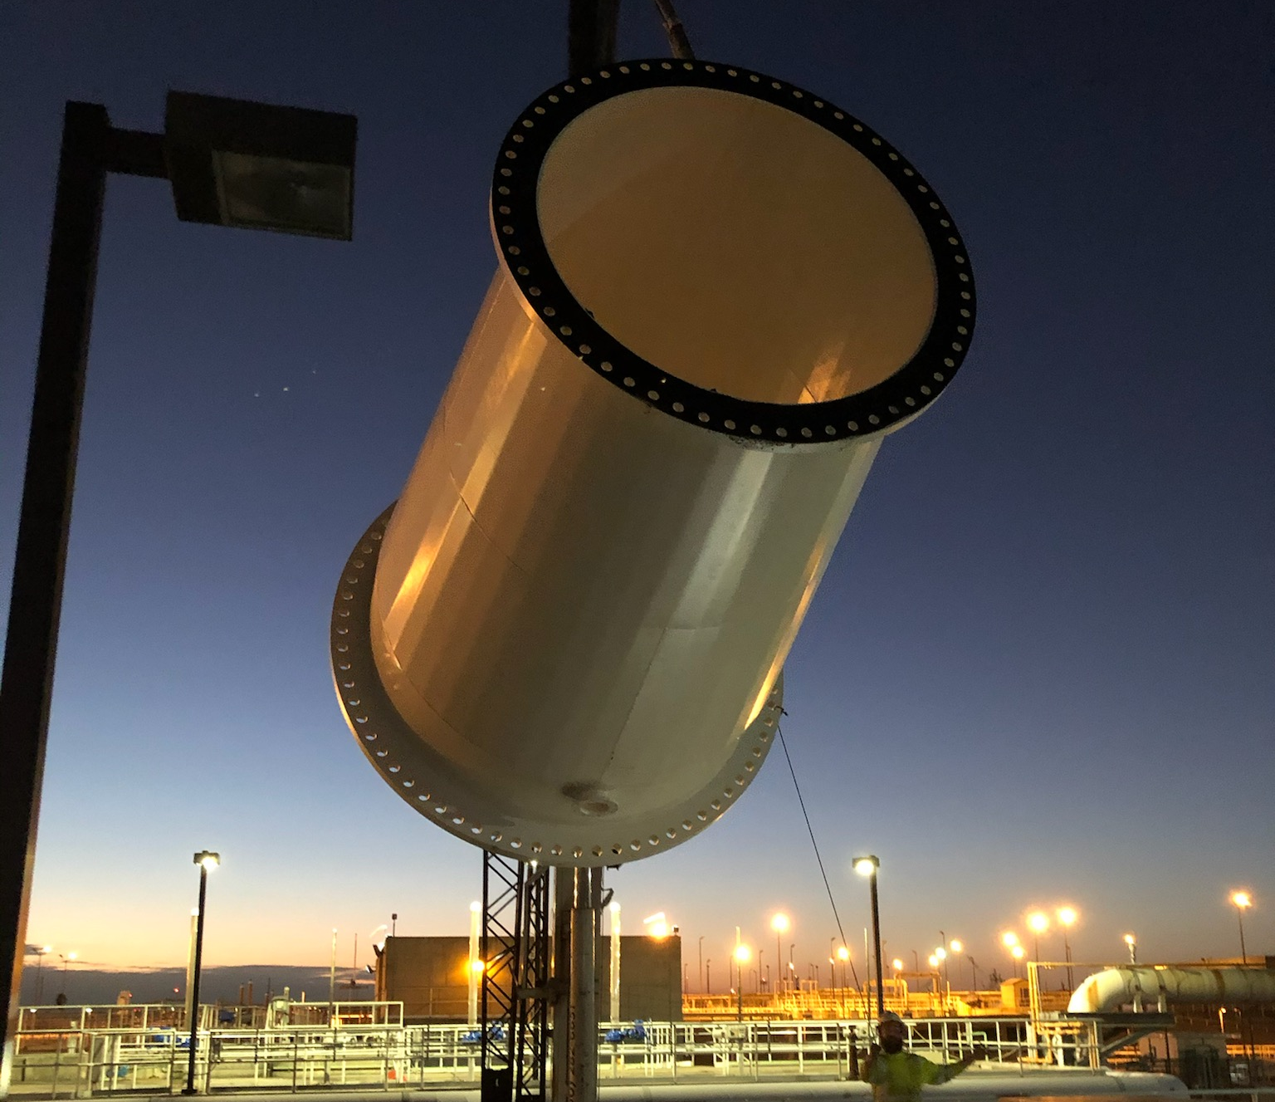
Emcor strengths
Significant expertise in project execution and managing skilled craft labor
Disciplined and effective cost management
Broad opportunities for earnings growth
History of consistent cash generation
Strong and liquid balance sheet

Slide 5
BROAD CONSTRUCTION & SERVICES PLATFORM 2022 REVENUES: $11.1B
CONSTRUCTION * |  |  | SERVICES
CONSTRUCTION SERVICES |  |  | BUILDING SERVICES |  |  |  |  |  |  |  | INDUSTRIAL SERVICES
Mechanical | Electrical |  | Mobile | Site-Based |  | Government |  |  | EMCOR UK |  | Refinery / Petro Chemical / Turnaround Services
Revenues $4.3B | Revenues $2.5B |  | Revenues $2.7B |  |  |  |  |  | Revenues $0.5B |  | Revenues $1.1B
Sheet Metal HVAC Process Piping High Purity Piping Plumbing Fire Protection Water and Wastewater | Low Voltage Voice & Data Lighting Security/Alarm High Voltage Transmission & Distribution Sustainable Energy Solutions |  | National HVAC Service Building Control Systems Retrofit Projects Repair Services Service Agreements IAQ Services | O&M HVAC Services Retrofit Projects Preventive Maintenance Energy Efficiency Upgrades | O&M HVAC Services Retrofit Projects Preventive Maintenance Energy Efficiency Upgrades | Base Ops Facilities Management IDIQ Projects O&M Supplier Management | Base Ops Facilities Management IDIQ Projects O&M Supplier Management |  | Integrated Facilities Services O&M Supplier Management |  | Heat Exchanger Services / Fabrication Embedded Contracts Turnaround Services Specialty Welding Maintenance & Capital Projects Process Controls Renewable Energy / Solar
* ~10% of construction revenues are services

Slide 6
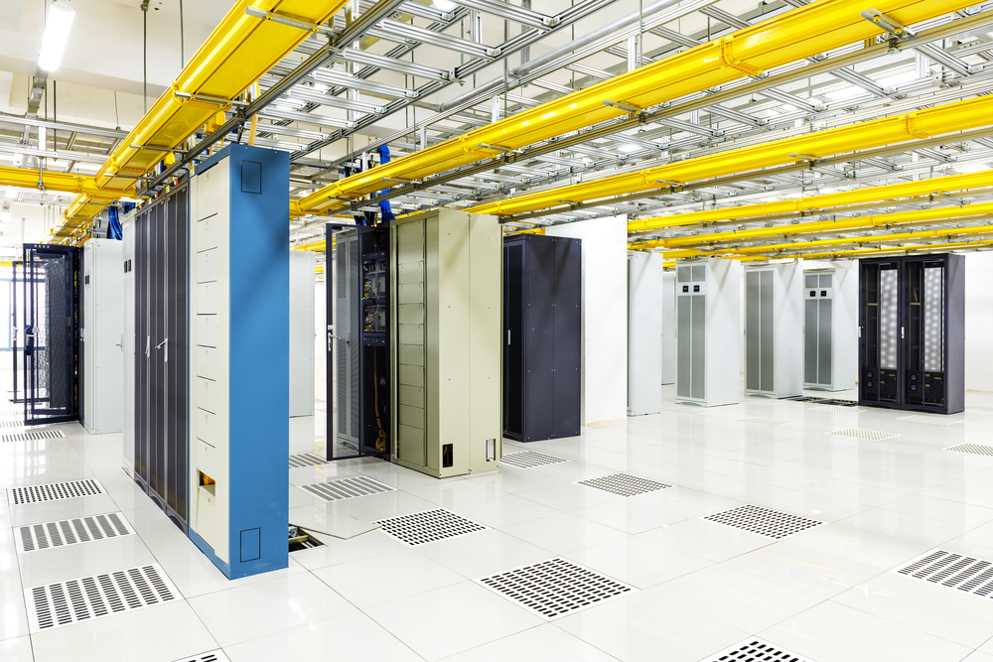
MARKET OUTLOOK – DATA CENTERS
Demand across Mid-Atlantic, Pacific Northwest, Midwest, and the Southeast remains strong
Electrical Construction
Mechanical Construction
Fire Protection Systems
CUSTOMER BASE
Technology Companies
Financial Firms
Co-locators
Government
“Average” Data Center Build % Ranges
Electrical Construction 30% - 50% *
Mechanical Construction 15% - 35% *
Fire Protection (Sprinkler Installation) 3% - 7%
* Includes purchase of major equipment

Slide 7
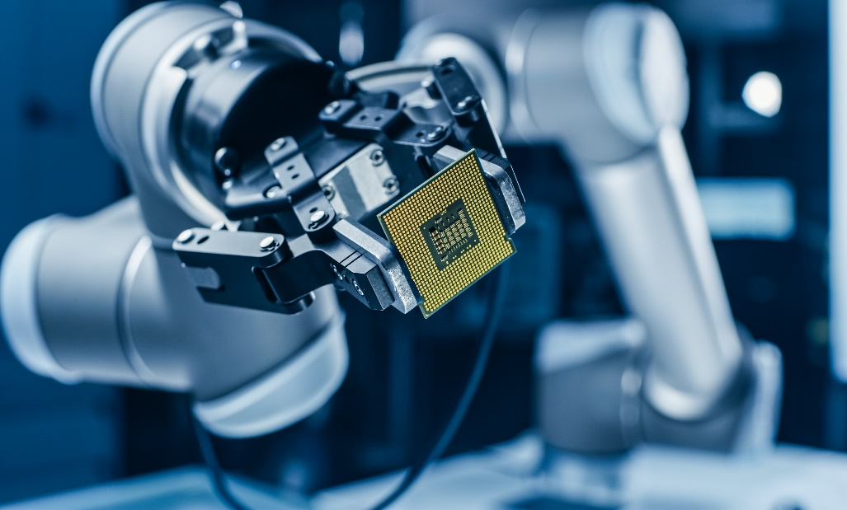
MARKET OUTLOOK – SEMICONDUCTOR
Increasing demand from our semiconductor customers
Traditional mechanical construction services
Fire protection services
High purity piping
Additional project opportunities bolstered by the CHIPS and Science Act of 2022

Slide 8
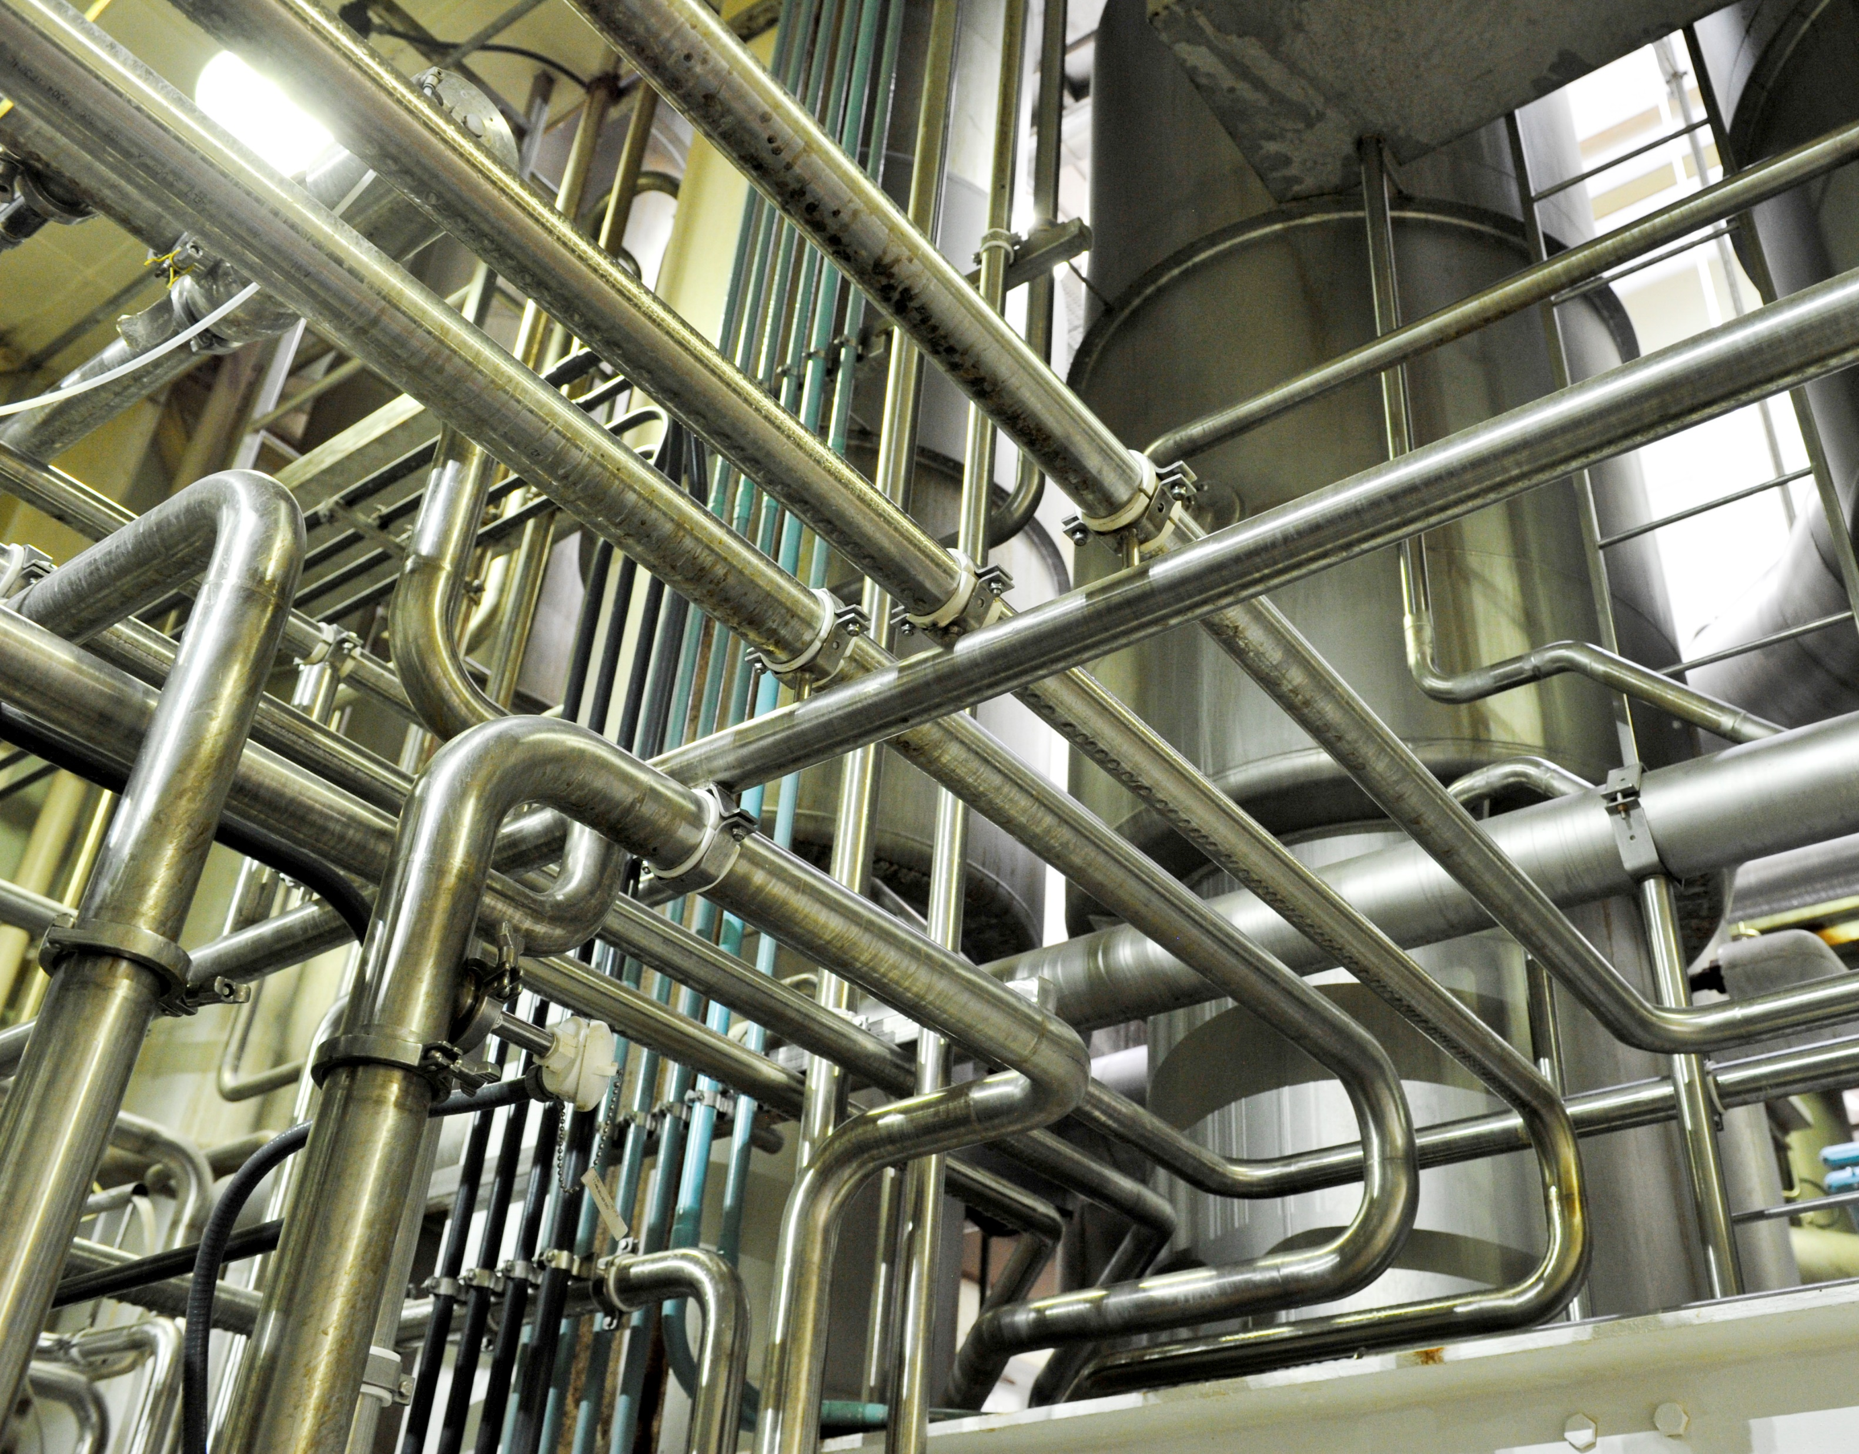
MARKET OUTLOOK – INDUSTRIAL / MANUFACTURING
Well-positioned for continued and increased investment in:
Re-shoring of Critical Supply
Food Processing
Pharmaceuticals
Building Products

Slide 9
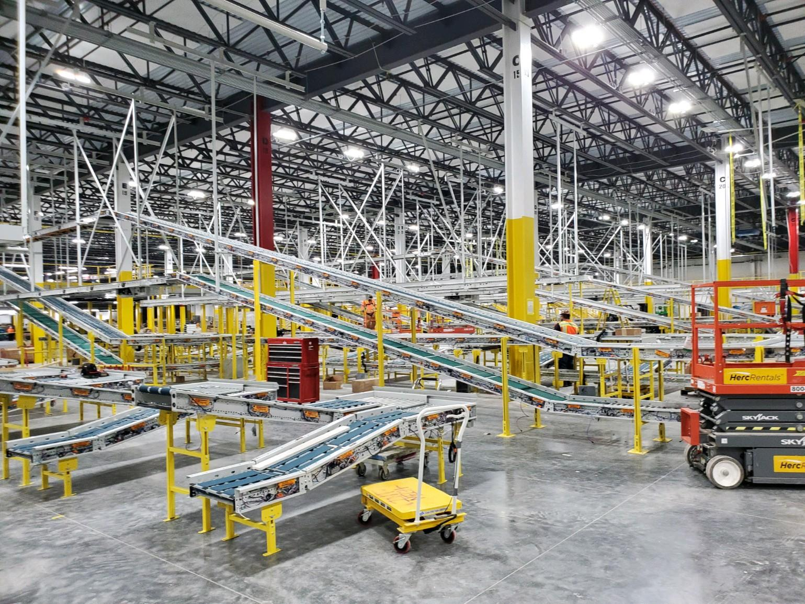
MARKET OUTLOOK – SUPPLY CHAIN SUPPORT / BUILD OUT
E-Commerce supply chain driving strong fire protection demand / moderate electrical services demand
Fire Protection Systems
Mechanical Construction
Active Aftermarket
CUSTOMER BASE
Technology Companies
Food Processing / Cold Storage
Distribution Centers

Slide 10
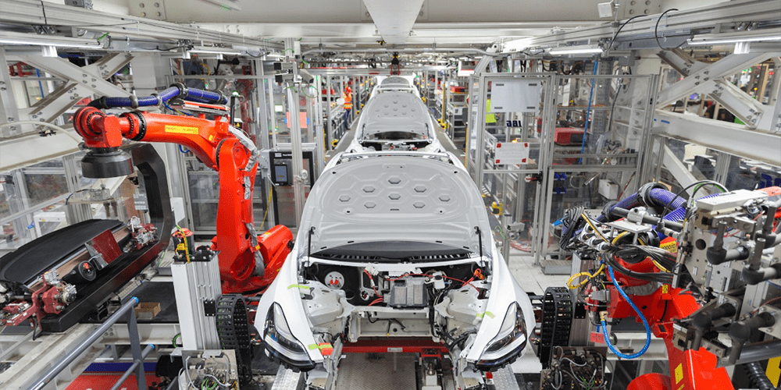
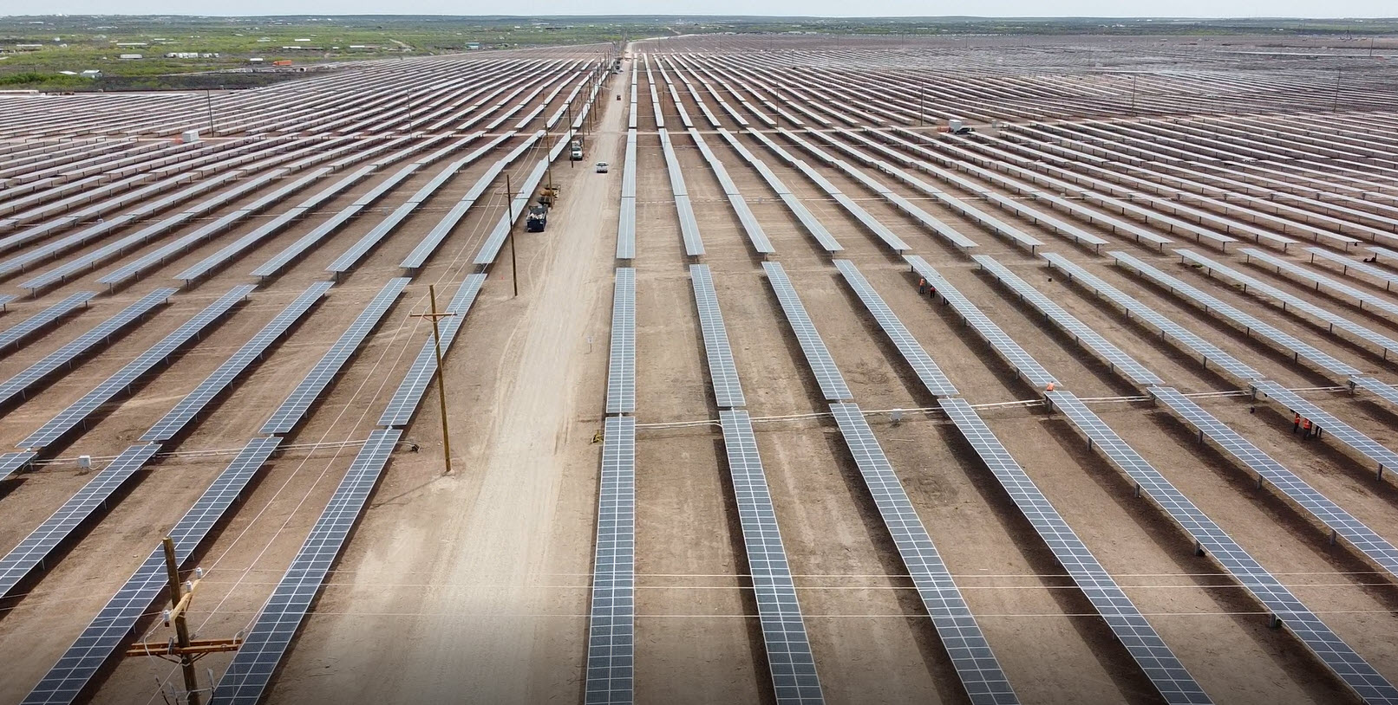
MARKET OUTLOOK – ENERGY TRANSITION / EXPANSION
EMCOR remains well positioned to assist its customers with the energy transition / expansion
EV and EV battery manufacturing facilities
Electrical charging stations on industrial scale
Large scale solar projects
Renewable buildout and grid modernization

Slide 11
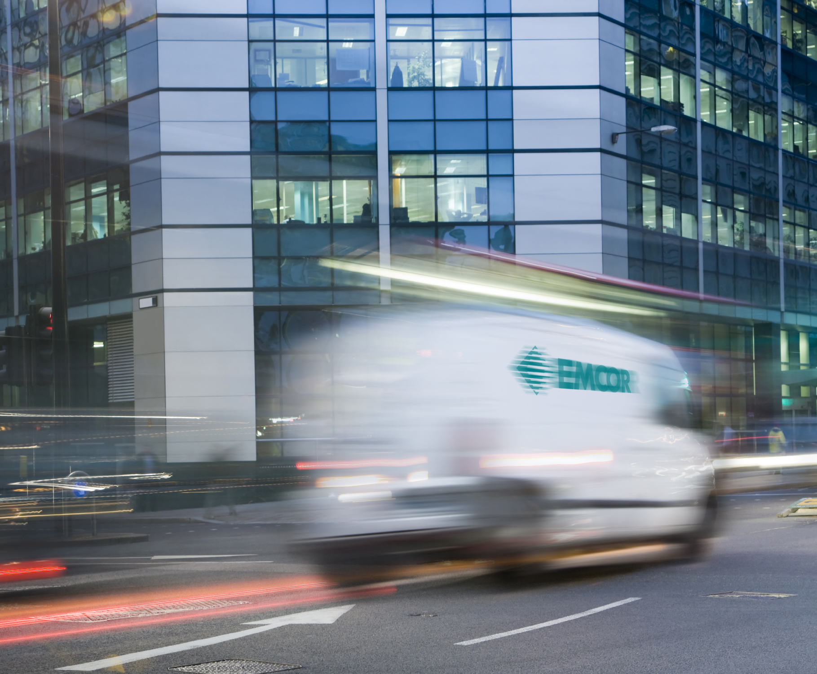
MARKET OUTLOOK – MECHANICAL SERVICES
Growing demand stemming from maintenance deferrals, retrofit opportunities, efficiency upgrades, customer decarbonization initiatives, and IAQ
Mobile Mechanical Services
Building Automation & Controls
CUSTOMER BASE
Commercial Buildings
National Brands and Organizations
Federal, State, and Local Government
Specialized Environments
Other Institutional Facilities
K-12 Schools / Universities
Healthcare Facilities

Slide 12
RPOs BY MARKET SECTOR – 12/31/22
Diverse Remaining Performance Obligations (RPOs) of $7.46 billion
6%
($ Millions) (Unaudited)
12/31/22
7%
3%
10%
49%
13%
10%
2%

Slide 13
RPOs – Commercial SUBMARKETS
($ Millions) (Unaudited)
Dec. 2022
vs.
Dec. 2021
Commercial Submarket Sectors
Traditional Commercial
Includes office, retail, restaurants, and warehouses
Telecommunications
Network & communications infrastructure
Includes data centers, data and fiber projects, cabling, etc.
High-Tech
R&D & high-tech manufacturing
Includes semiconductor, biotech, life-sciences, pharmaceutical, and EV/battery plants
21%
111%
108%
Nearly 75% of the year-over-year growth in our commercial market sector RPOs is driven by the “Telecommunications” and the “High-Tech” submarket sectors

Slide 14
PRIORITIZING SUSTAINABILITY
Our Mission First, People Always values continue to guide our sustainability strategy
Recent Updates
Aligned our sustainability reporting with the Sustainability Accounting Standards Board (SASB) standard for the Engineering & Construction Services industry, in-line with our shareholders’ expectations and our commitment to strong sustainability practices Incorporated guidance from the recommendations of the Task Force on Climate-Related Financial Disclosures (TCFD) to disclose scope 1, scope 2, and scope 3 greenhouse gas emissions metrics and set forward-looking reduction goals for scope 1 and scope 2
Our Initial 2035 Energy and Emissions Goals
Committed to the Health & Safety of our Workforce
30-40%
Per capita reduction in carbon-based fuel consumption across service fleet
We maintain a strong commitment to safety throughout our operations, striving for a zero injury environment and culture across our 100 operating subsidiaries
2022
TRIR
Industry Average
20%
Reduction in per capita scope 1 and scope 2 greenhouse gas output
1.2
2.7
We maintain our position as an industry leader in safety and continue to make progress toward our goal of zero workplace injuries
Our Board and management team continue to oversee our ESG practices and guide our strategy as we progress our goals and initiatives

Slide 15
KEY FINANCIAL DATA – INCOME STATEMENT
($ Thousands, except per share information)

Slide 16
KEY FINANCIAL DATA – BALANCE SHEET
($ Thousands)

Slide 17
EMCOR CAPITAL ALLOCATION TRENDS
EMCOR Capital Allocation by Year (%)
~55%
~45%
Business Reinvestment
Shareholder Return
Acquisitions
Capex
Dividends
Share Repurchases

Slide 18
GROWTH OPPORTUNITIES
Data Centers / Semiconductor Fabs | Strong electrical / mechanical / fire protection demand across numerous geographic regions; RPOs continue to grow
Industrial / Manufacturing | Growing electrical / mechanical opportunities driven by continued re-shoring of supply chain and relocations from higher-cost states
Healthcare | Electrical / mechanical system retrofits as hospitals upgrade their existing facilities and build new facilities
Energy Transition / Transportation | Growing demand for EV transition across entire value chain; EV and EV battery manufacturing facilities; electrical charging stations on industrial scale; renewable buildout, natural gas backup facilities
Water & Wastewater | Demand for comprehensive construction services, especially Florida
Mechanical Services | Growing mechanical service and repair demand stemming from pandemic maintenance deferrals, retrofit opportunities, energy efficiency upgrades, customer decarbonization initiatives, and delays in receipt of new HVAC equipment
Indoor Air Quality | Nationwide mechanical systems retrofit projects to improve building wellness with significant opportunities in the Institutional and Education sectors
Fire Protection / Life Safety | Nationwide fire sprinkler installation capability / substantial cost efficiencies via prefabrication / strong demand from industrial and technology clients / growing aftermarket

Slide 19
2023 GUIDANCE
Revenues $12.0 - $12.5 Billion
Diluted EPS* $8.75 - $9.50
* Assumes ~28.0% effective tax rate

